Slide 1
Introduction to Exceptions in Java

Slide 2
Exceptions
Exception: an abnormal or erroneous situation at runtime
Examples:
Array index out of bounds
Division by zero
Illegal input number format
Following a null reference
2

Slide 3
Exceptions
These erroneous situations throw an exception
Exceptions can be thrown by the Java virtual machine or by the program
3

Slide 4
Catching and re-Throwing Exceptions
The calling method can either catch an exception or it can re-throw it.
The method catches the exception if it knows how to deal with the error.
Otherwise the exception is re-thrown.
4

Slide 5
Catching Exceptions
How try-catch works:
When the try-catch statement is executed, the statements in the try block are executed
If no exception is thrown:
Processing continues as normal
If an exception is thrown:
Program enters in "panic mode" and control is immediately passed to the first catch clause whose specified exception corresponds to the class of the exception that was thrown
5

Slide 6
Catching Exceptions
If an exception is not caught and handled inside the method where it occurs:
Control is immediately returned to the method that invoked the method that produced the exception
If that method does not handle the exception (via a try statement with an appropriate catch clause) then control returns to the method that called it …
This process is called propagating the exception
6

Slide 7
Catching Exceptions
Exception propagation continues until
The exception is caught and handled
Or until it is propagated out of the main method, resulting in the termination of the program
7

Slide 8
Catch Blocks
A single catch block can handle more than one type of exception.
This can reduce code duplication.
In the catch clause we specify the types of exceptions that the block can handle and separate each exception type with a vertical bar (|).
8

Slide 9
A Try-Catch Example with Multiple Catch Statements
The try-catch syntax:
try {
code
}
catch(exception1 e) {statements}
catch(exception2 e) {statements}
catch(exception3|exception4 e){statements}
9

Slide 10
Java Exceptions
In Java, an exception is an object
There are Java predefined exception classes, like
ArithmeticException
IndexOutOfBoundsException
IOException
NullPointerException
10

Slide 11
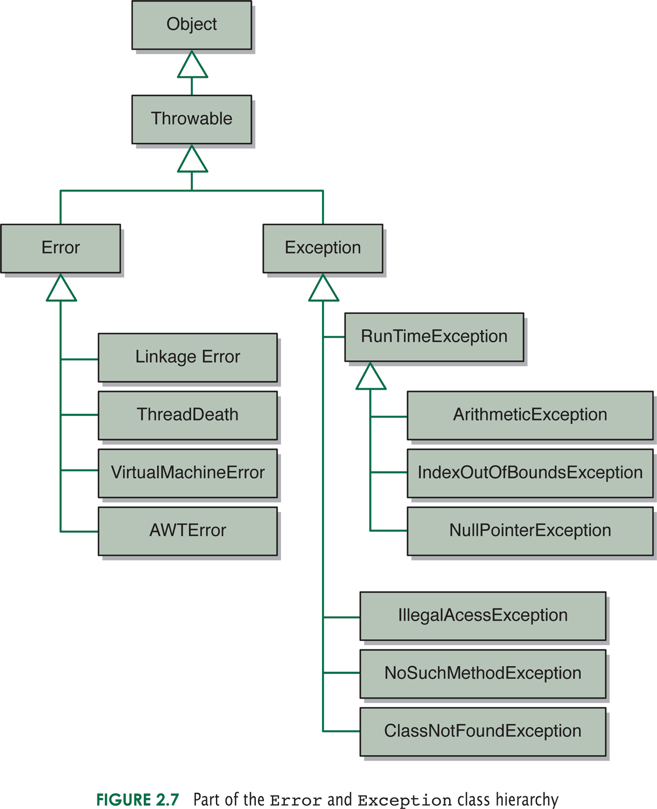
Some Java Error and Exception Classes
11

Slide 12
Runtime Errors
Java differentiates between runtime errors and exceptions
Errors are unrecoverable situations, so the program must be terminated
Example: running out of memory
12

Slide 13
Exceptions
Exception: an abnormal or erroneous situation at
runtime
Examples:
Division by zero
Array index out of bounds
Null pointer exception
Exceptions can be thrown by the program or by
the Java virtual machine, for example for this statement
i = size / 0;
The virtual machine will throw an exception
13

Slide 14
Declaring Exception Classes
public class EmptyStackException extends RuntimeException {
public EmptyStackException (String msg) {
super (msg);
}
}
14

Slide 15
Checked and Unchecked Exceptions
Checked exceptions are checked by the compiler
Unchecked exceptions are not
15

Slide 16
Example: Checked Exception
import java.io.*;
class Main {
public static void main(String[] args) {
try {
FileReader file = new FileReader("test.txt");
BufferedReader fileInput = new BufferedReader(file);
System.out.println(fileInput.readLine());
fileInput.close();
}
catch (FileNotFoundException e) { ... }
catch (IOException e) { ... }
}
}
16

Slide 17
Example: Checked Exception
import java.io.*;
class Main {
public static void main(String[] args) {
FileReader file = new FileReader("test.txt");
BufferedReader fileInput = new BufferedReader(file);
System.out.println(fileInput.readLine());
fileInput.close();
}
}
The compiler gives the error:
Main.java:5: error: unreported exception FileNotFoundException; must be caught or declared to be thrown
FileReader file = new FileReader("test.txt");
17

Slide 18
Example: UnChecked Exception
class Main {
public static void main(String[] args) {
int x = 10;
int y = 0;
int z = x / y;
}
}
The compiler does not give an error even though we are
dividing by zero.
18

Slide 19
How do Exceptions Affect the Program Execution?
If the offending line is within a try-statement:
Lines of code after this line, within the try area, will not execute
Line of code below the entire try-catch structure will only execute if the exception is caught
19

Slide 20
How do Exceptions Affect the Program Execution?
If the offending line is not within a try-statement:
Lines of code after this line will not execute
An exception can only be caught once. It cannot be caught and then propagate to be re-caught.
20

Slide 21
A Try-Catch Example with Multiple Catch Statements and a finally Block
The try-catch-finally syntax:
try {
code
}
catch(exception1 e) {statements}
catch(exception2 e) {statements}
catch(exception3|exception4 e){statements}
finally {statements}
21

Slide 22
Finally Block
The finally block always executes when the try block exits, whether an exception was thrown or not (even if the exception was not caught by any of the catch statements!)
The finally block is executed even if there is a return statement inside the try or catch blocks or if a new exception is thrown.
22

Slide 23
No finally Block
PrintWriter out;
try {
out = new PrintWriter(new FileWriter("OutFile.txt"));
out.println("Data");
int x = 5 / 0;
}
catch(FileNotFoundException e) {…}
catch(IOException e) {…}
if (out != null) out.close();
The exception caused by dividing 5 by 0 will not be caught, so the statement out.close() will not be executed, so the file will not be closed, and the data will not be stored in it.
23

Slide 24
Code with finally Block
PrintWriter out = null;
try {
out = new PrintWriter(new FileWriter("OutFile.txt"));
out.println("Data");
int x = 5 / 0;
}
catch(FileNotFoundException e) {…}
catch(IOException e) {…}
finally {
if (out != null) out.close();
}
The file will be closed.
24

Slide 25
private static void method2(String str) {
if (str.length() > 0) ++x;
else
throw new Exception1("Empty string");
s = "hello";
throw new Exception2("Long string");
}
public class ExceptionExample {
private static int x = 1;
private static String s = "";
public static void main(String[] args) {
try {
method1(2);
method1(1);
x = x + 3;
}
catch (Exception1 e) {x = 0;}
catch (Exception2 ex) {x = x + 5;}
System.out.println(x+", "+s);
}
private static void method1(int param) throws Exception1, Exception2 {
try {
if (param == 1) method2("hello");
else method2(s);
++x;
}
catch (Exception1 e) {
System.out.println(e.getMessage());
s = "hi";
}
}
Hand-trace through this
code. What is printed
by the program?
25

